Slide 1
Transforming Physical Training with Real-time Pose Analysis using MoveNet
Dr.Paulin Paul Assistant Professor, Amal Jyothi College of
Engineering,Kanjirappally
Vidhu krishnan Vinod PG Scholar
Amal Jyothi College of Engineering, Kanjirappally

Slide 2
CONTENTS
Introduction
Literature Survey
Proposed System
Methodology
Results and Discussion
Conclusion
References

Slide 3
INTRODUCTION
Our proposed system is intricately designed with a clear objective: to utilize MoveNet technology for a groundbreaking approach to physical training. It seamlessly combines various elements, including live video feeds, precise capture of key body points, calculation of motion angles, real-time updates on repetition counts, and immediate feedback to users. It goes beyond the simple task of counting push-ups, focusing on fundamentally reshaping how individuals engage with fitness.
5
2

Slide 4
Literature Survey
"MoveNet: Ultra-fast and accurate pose detection model" [1]
Provides insights into technical aspects and applications of MoveNet.
"Human Pose Classification with MoveNet and TensorFlow Lite implementation details and its performance" [2]
Focuses on pose estimation and classification with MoveNet and TensorFlow Lite, including implementation details and performance.

Slide 5
Literature Survey(cntd..)
"Pose estimation and classification on edge devices with MoveNet and TensorFlow Lite" [4]
Discusses using MoveNet for pose estimation and classification on edge devices, making it suitable for real-world applications with resource constraints.
"Next-Generation Pose Detection with MoveNet and TensorFlow.js" [5]
Presents MoveNet as a next-generation pose detection model, delving into its architecture and approach to accurate human pose detection, along with a guide to its performance compared to other pose detection technologies.

Slide 6
Proposed System
MoveNet Integration: The core of our system involves the integration of MoveNet, a specialized model for precise human body key point detection.
Real-time Tracking: MoveNet offers real-time tracking of 17 key body points, enabling instant feedback and performance evaluation.
Exercise Specificity: Our system focuses on exercise modules, particularly during activities like push-ups, to provide tailored feedback.

Slide 7
Methodology
Basic Terminologies
MoveNet: MoveNet is a specialized model for speedy and accurate human body key point detection. It offers two versions, "Lightning" for rapid results and "Thunder" for higher precision.
The architecture consists of two components: a feature extractor and a set of prediction heads

Slide 8
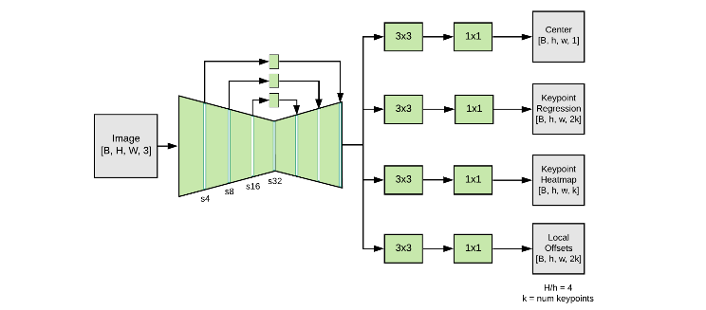
METHODOLOGY(cntd..)

Slide 9
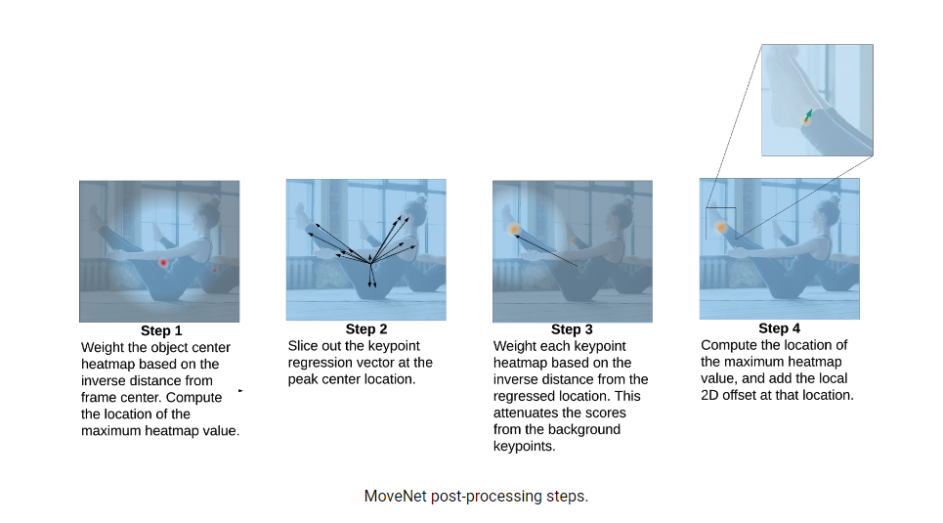
METHODOLOGY(cntd..)

Slide 10
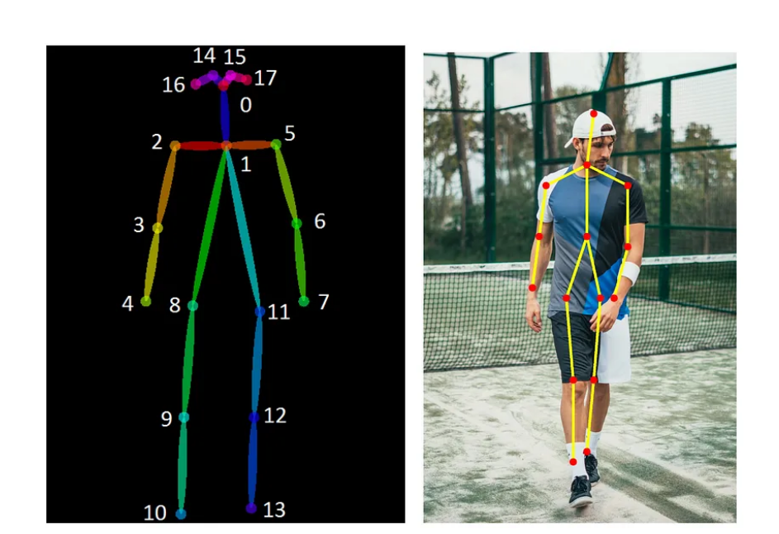
METHODOLOGY(cntd..)
Pose Estimation: The process of determining key body points in images or videos. MoveNet excels by identifying 17 key body points, enabling exercise tracking and health monitoring.

Slide 11
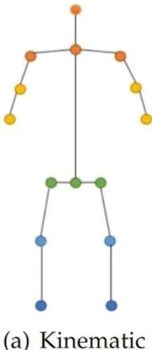
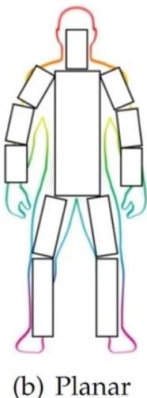
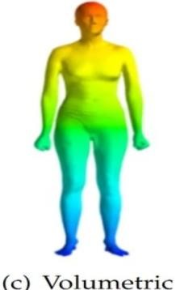
METHODOLOGY(cntd..)
There are three types of models for human body modeling:
● Kinematic Model
● Planar Model
● Volumetric Model
Real-time Performance: The ability to process and analyze data quickly. MoveNet can achieve pose estimation at speeds exceeding 30 FPS, making it ideal for time-sensitive applications.

Slide 12
METHODOLOGY(cntd..)
Data Collection
Data Source: Live video recordings of individuals performing push-up exercises in real-time.
Data Preparation (Video Segmentation): Employed real-time segmentation techniques to isolate individual push-up repetitions.
Data Labeling: Manually labeled key points representing body landmarks for each frame in live video streams.

Slide 13
METHODOLOGY(cntd..)
Model Tuning
Pose Detection: We used MoveNet for real-time pose detection to track body locations during live push-ups.
Key Point Detection: MoveNet was employed to detect keypoints in real-time for each frame of live video streams.
Key Point Tracking: Real-time tracking of key points, including wrists and shoulders, to monitor body movements during live push-ups.

Slide 14
METHODOLOGY(cntd..)
Pose Analysis
Repetition Detection: Identified push-up repetitions by tracking upward and downward body motion in real-time.
Correctness Evaluation: Analyzed body keypoints alignment with correct push-up form in real-time.
Data Visualization: Used real-time data visualization to illustrate push-up form correctness and identify deviations during live sessions.

Slide 15
RESULTS AND DISCUSSION
Real-Time Accuracy: The accuracy of our real-time pose detection with MoveNet was found to be exceptional.
Speed: The system maintained high-speed performance
Visual insights into the performance of our system during push-up exercises. We present three key images that illustrate different aspects of the user's experience

Slide 16
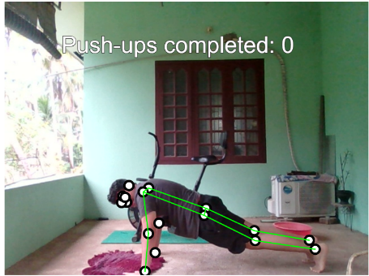
RESULTS AND DISCUSSION
Push-Up Starting Position:
This image represents the initial posture when the user is in the starting position for a push-up exercise.

Slide 17
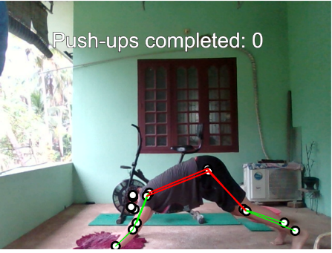
RESULTS AND DISCUSSION
Posture Error Detection:
In this image, red lines are overlaid on the user's body to indicate posture errors during a push-up.
The system highlights areas where the user's posture deviates from the correct form.

Slide 18
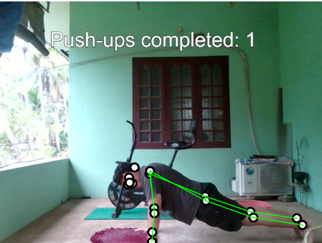
RESULTS AND DISCUSSION
Successful Repetition:
This image showcases a successful push-up repetition with proper posture.
The absence of red lines indicates that the user maintained the correct form.

Slide 19
RESULTS AND DISCUSSION
Benefits of Real-Time Tracking: Real-time tracking of key body points was a significant advantage, enabling immediate feedback and performance correction.
Applications: Our system's applications extend beyond fitness and can be used in healthcare, sports analysis, and entertainment.
Future Enhancements: Future developments may focus on expanding the range of supported exercises and improving keypoints tracking accuracy.

Slide 20
CONCLUSION
MoveNet vs. Other Main Detection Models: MoveNet stands out as a superior solution among leading pose detection models, offering an impressive combination of speed, accuracy, and robustness.
Speed: MoveNet's remarkable speed is particularly well-suited for real-time pose estimation, making it an excellent choice for applications requiring instantaneous pose analysis.
Accuracy: Its higher accuracy, even in challenging poses and scenarios with occluded joints, broadens its applicability to a wide range of use cases, outperforming other models.
Robustness: MoveNet's ability to handle noise, lighting variations, and varying image quality places it at the forefront for real-world applications where conditions are less than ideal.

Slide 21
CONCLUSION
Real-World Applications: MoveNet's practical advantages shine in real-world applications, including fitness tracking, virtual reality, and augmented reality, where it offers a compelling edge over competing models.
Superior Solution: MoveNet emerges as the dominant pose detection model, providing unmatched speed, accuracy, and versatility when compared to other prominent models in the field.

Slide 22
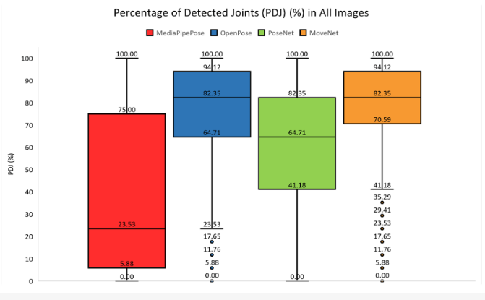
CONCLUSION

Slide 23
CONCLUSION
In the evaluation of Human Pose Estimation (HPE) libraries, MoveNet proved to be the top performer, showcasing superior performance across various statistical measures. OpenPose closely followed, but MoveNet maintained an edge in key metrics. Pose Net, although the third-best, outperformed MediaPipe Pose. It's worth noting that both MediaPipe Pose and PoseNet encountered issues with incorrect keypoints matches.
Furthermore, MoveNet consistently excelled in the categorized performance analysis, particularly in the 0-25% range, highlighting its outstanding performance and reliability. These results affirm MoveNet's status as a robust choice for applications dependent on precise pose estimation.

Slide 24
REFERENCES
1. [TensorFlow - Pose estimation using MoveNet](https://www.tensorflow.org/lite/examples/pose_estimation/overview)
2. [V7 Labs - A Comprehensive Guide to Human Pose Estimation](https://www.v7labs.com/blog/human-pose-estimation-guide)
3. [MDPI - Comparative Analysis of Skeleton-Based Human Pose Detection](https://www.mdpi.com/1999-5903/14/12/380)
4. [MDPI - Comparative Analysis of Skeleton-Based Human Pose Detection (Specifically about MoveNet)](https://www.mdpi.com/1999-5903/14/12/380)

Slide 25
REFERENCES
5. [Analytics Vidhya - A Comprehensive Guide on Human Pose Estimation](https://www.analyticsvidhya.com/blog/2022/01/a-comprehensive-guide-on-human-pose-estimation/)
6. [Comparative Analysis of OpenPose, PoseNet, and MoveNet (Reference for MoveNet)](https://oa.mg/work/10.18280/ts.390111)
7. [IEEE Xplore - Real-time Human Pose Estimation on a Mobile Device](https://ieeexplore.ieee.org/document/8899480)
8. [Springer - 3D Human Pose Estimation: A Review](https://link.springer.com/chapter/10.1007/978-3-030-51054-6_13)

Slide 26
THANK YOU

